Slide 1
Tezos Blockchain Camp
Tezos Smart Contract

Slide 2
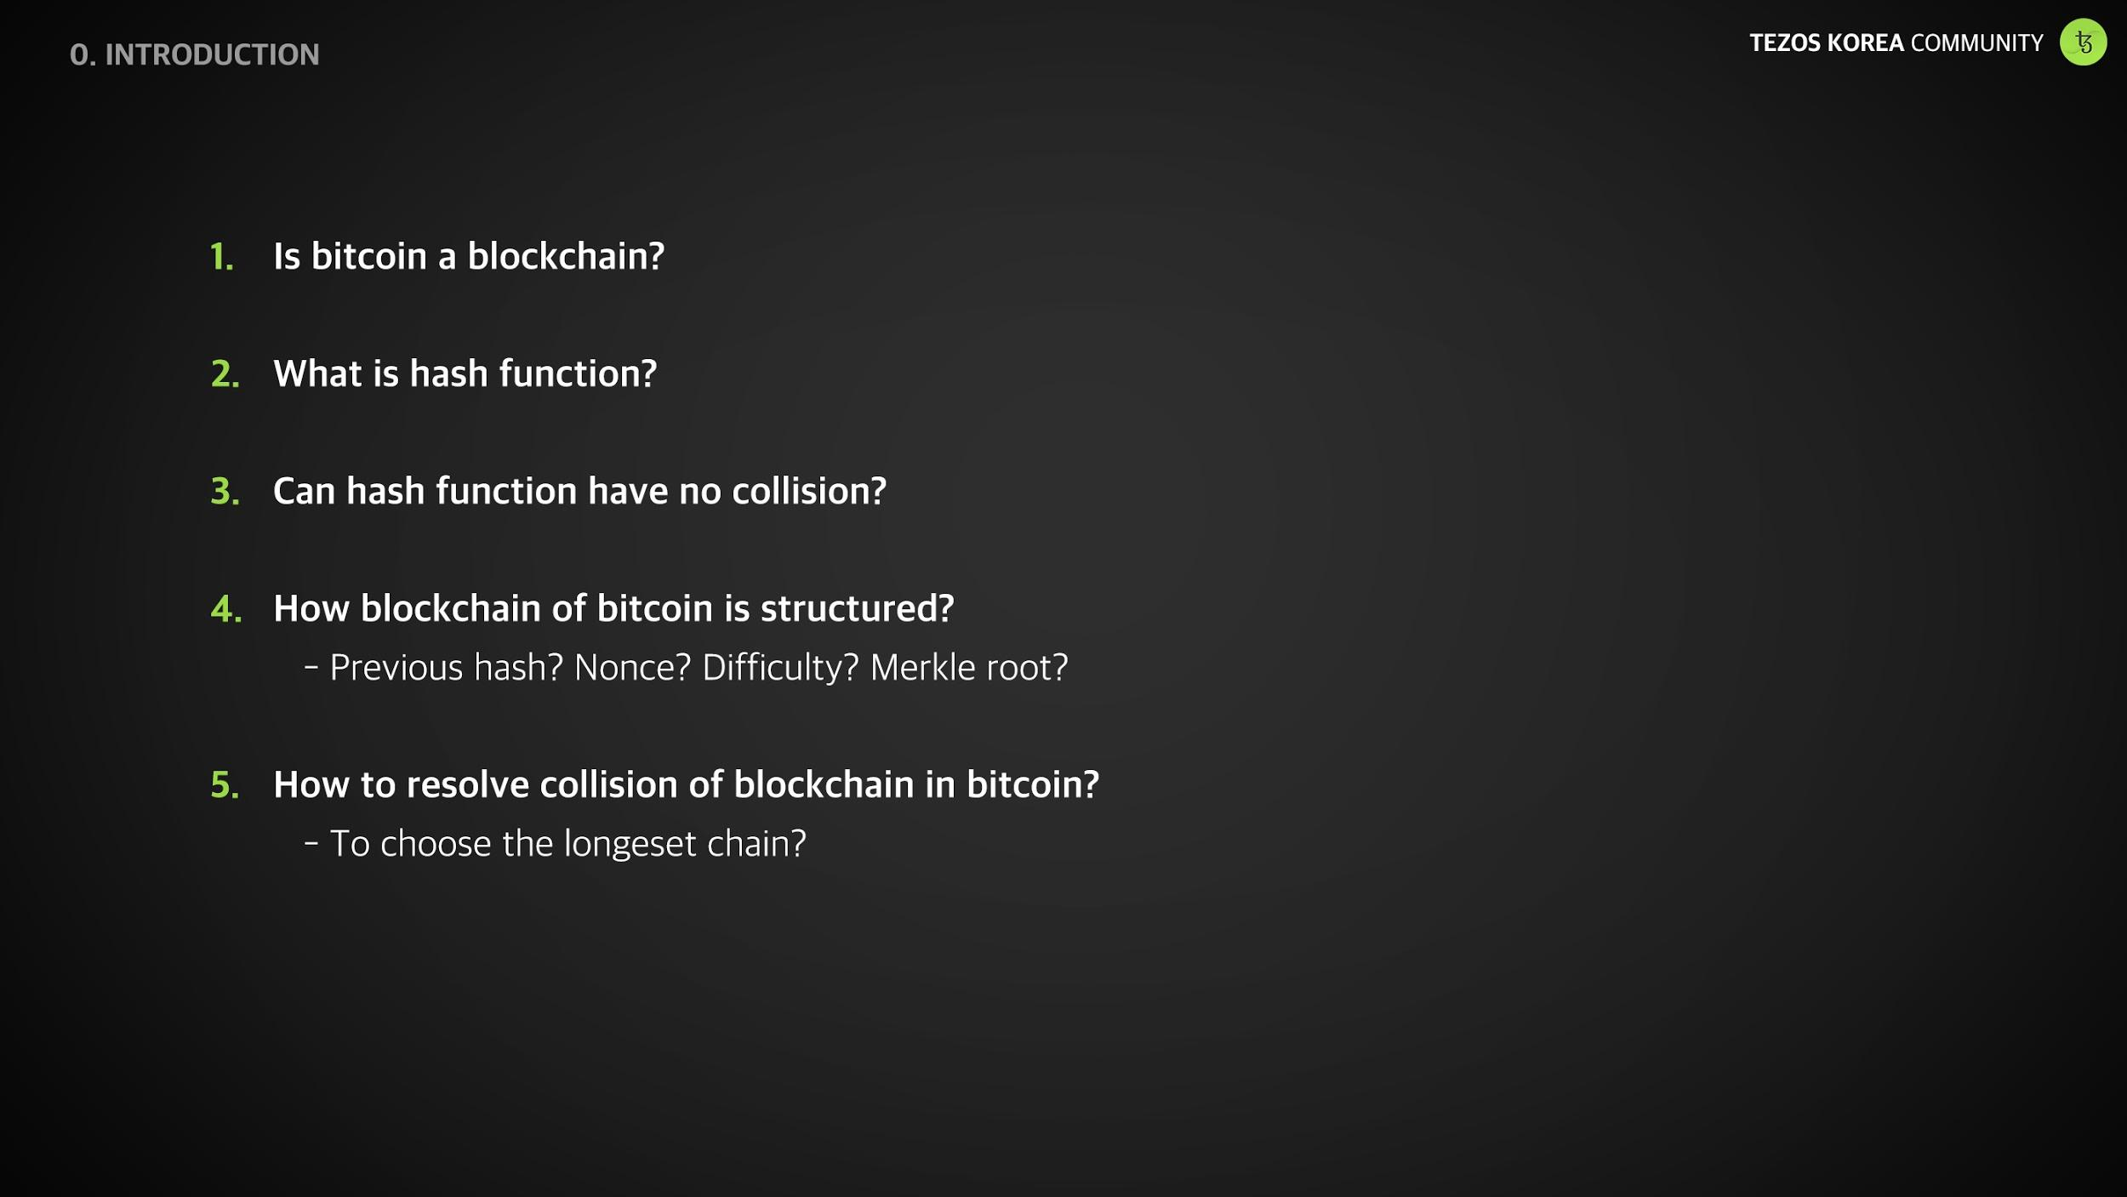

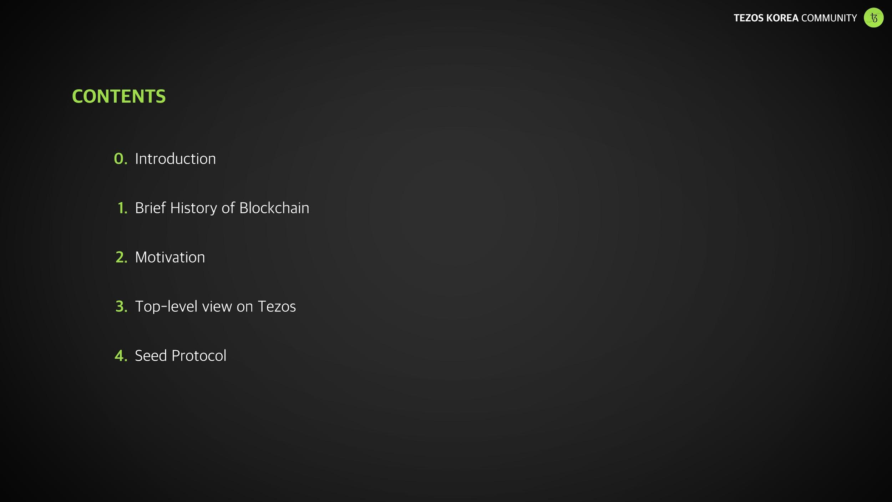
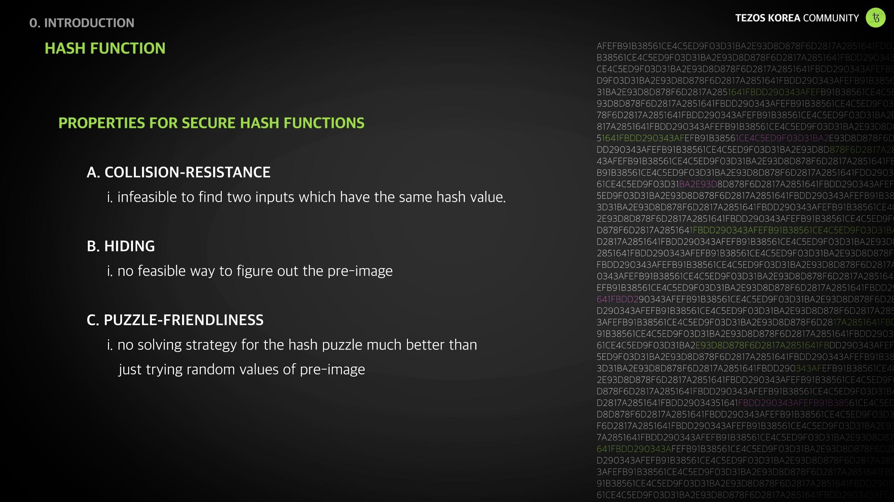
Smart Contract
TEZOS KOREA
Environment Setting
- Tezos Alphanet
- Liquidity ^0.5
- DB for fast sync

Slide 3
Smart Contract
TEZOS KOREA
Contract Type
- Stateful accounts (vs. UTxO) - Account = Contracts
Default(Implicit) Account: A pair of (pk, sk), Contracts with no executable code (tz1…, tz2…, tz3…)
Originated Account: Contract, Contracts with executable code (KT…)
- Manager, Delegate, Delegatable, Spendable, ...

Slide 4
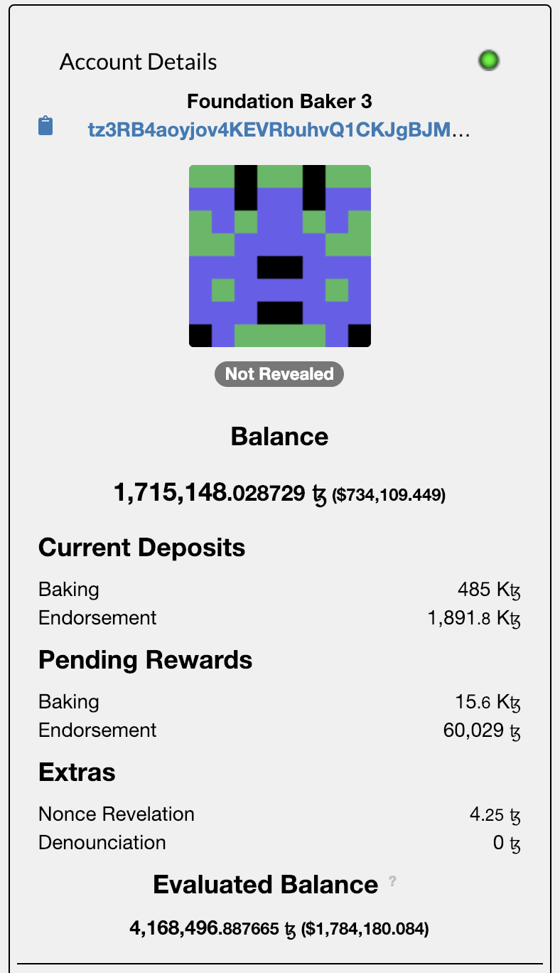
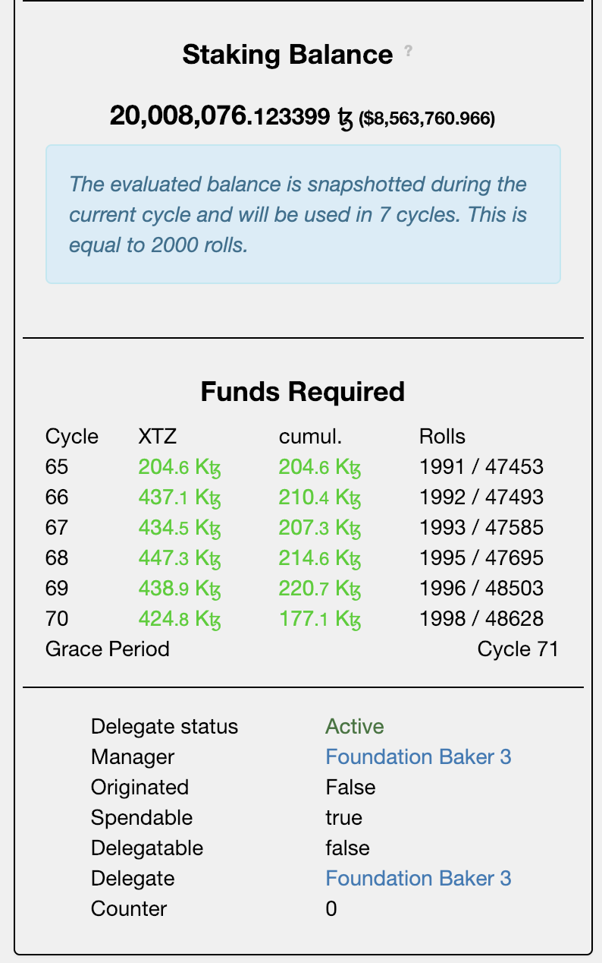
Smart Contract
TEZOS KOREA
Contract Type
- Manager, Delegate, Delegatable, Spendable
- 베이킹은 implicit account로만 가능 (security deposit)
- Implicit account는 delegate를 설정할 수 없음
- 위임(delegation)은 originated account(KT…)의 balance로만 가능

Slide 5
Smart Contract
TEZOS KOREA
Origination
- 컨트랙트(KT1…)를 생성
- 코드와 스토리지 초기값을 명시
- Active한 상태를 유지하기 위해서는 balance가 1 tez 이상이어야 함
Transaction
- 컨트랙트(account)간 이동하는 메세지 (tz ⇄ tz, kt ⇄ kt, tz ⇄ kt)
- Manager의 비밀키로 디지털 서명이 이루어져야 함
- 스마트 컨트랙트 호출
- replay attack을 방지하기 위한 counter

Slide 6
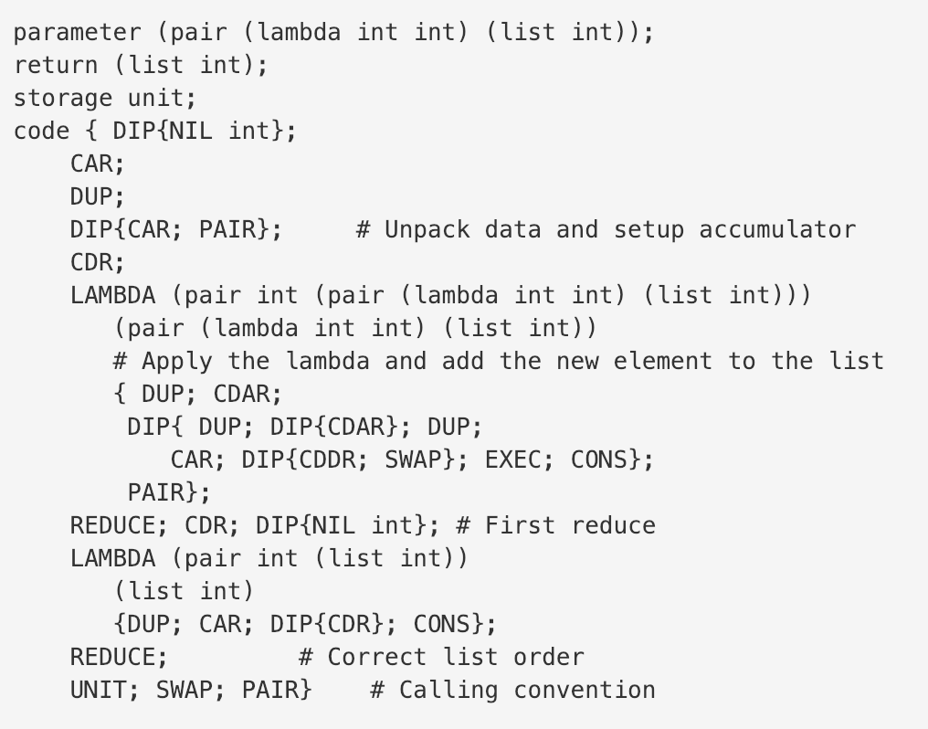
Smart Contract
TEZOS KOREA
Language
- Native language(compile target, run in VM): Michelson
DSL(Domain Specific Language) for automated escrow
stack based
strict static type checking
support formal verification
human readable (high level constructs)
- High level language Liquidity, Haskell, fi, ergo

Slide 7
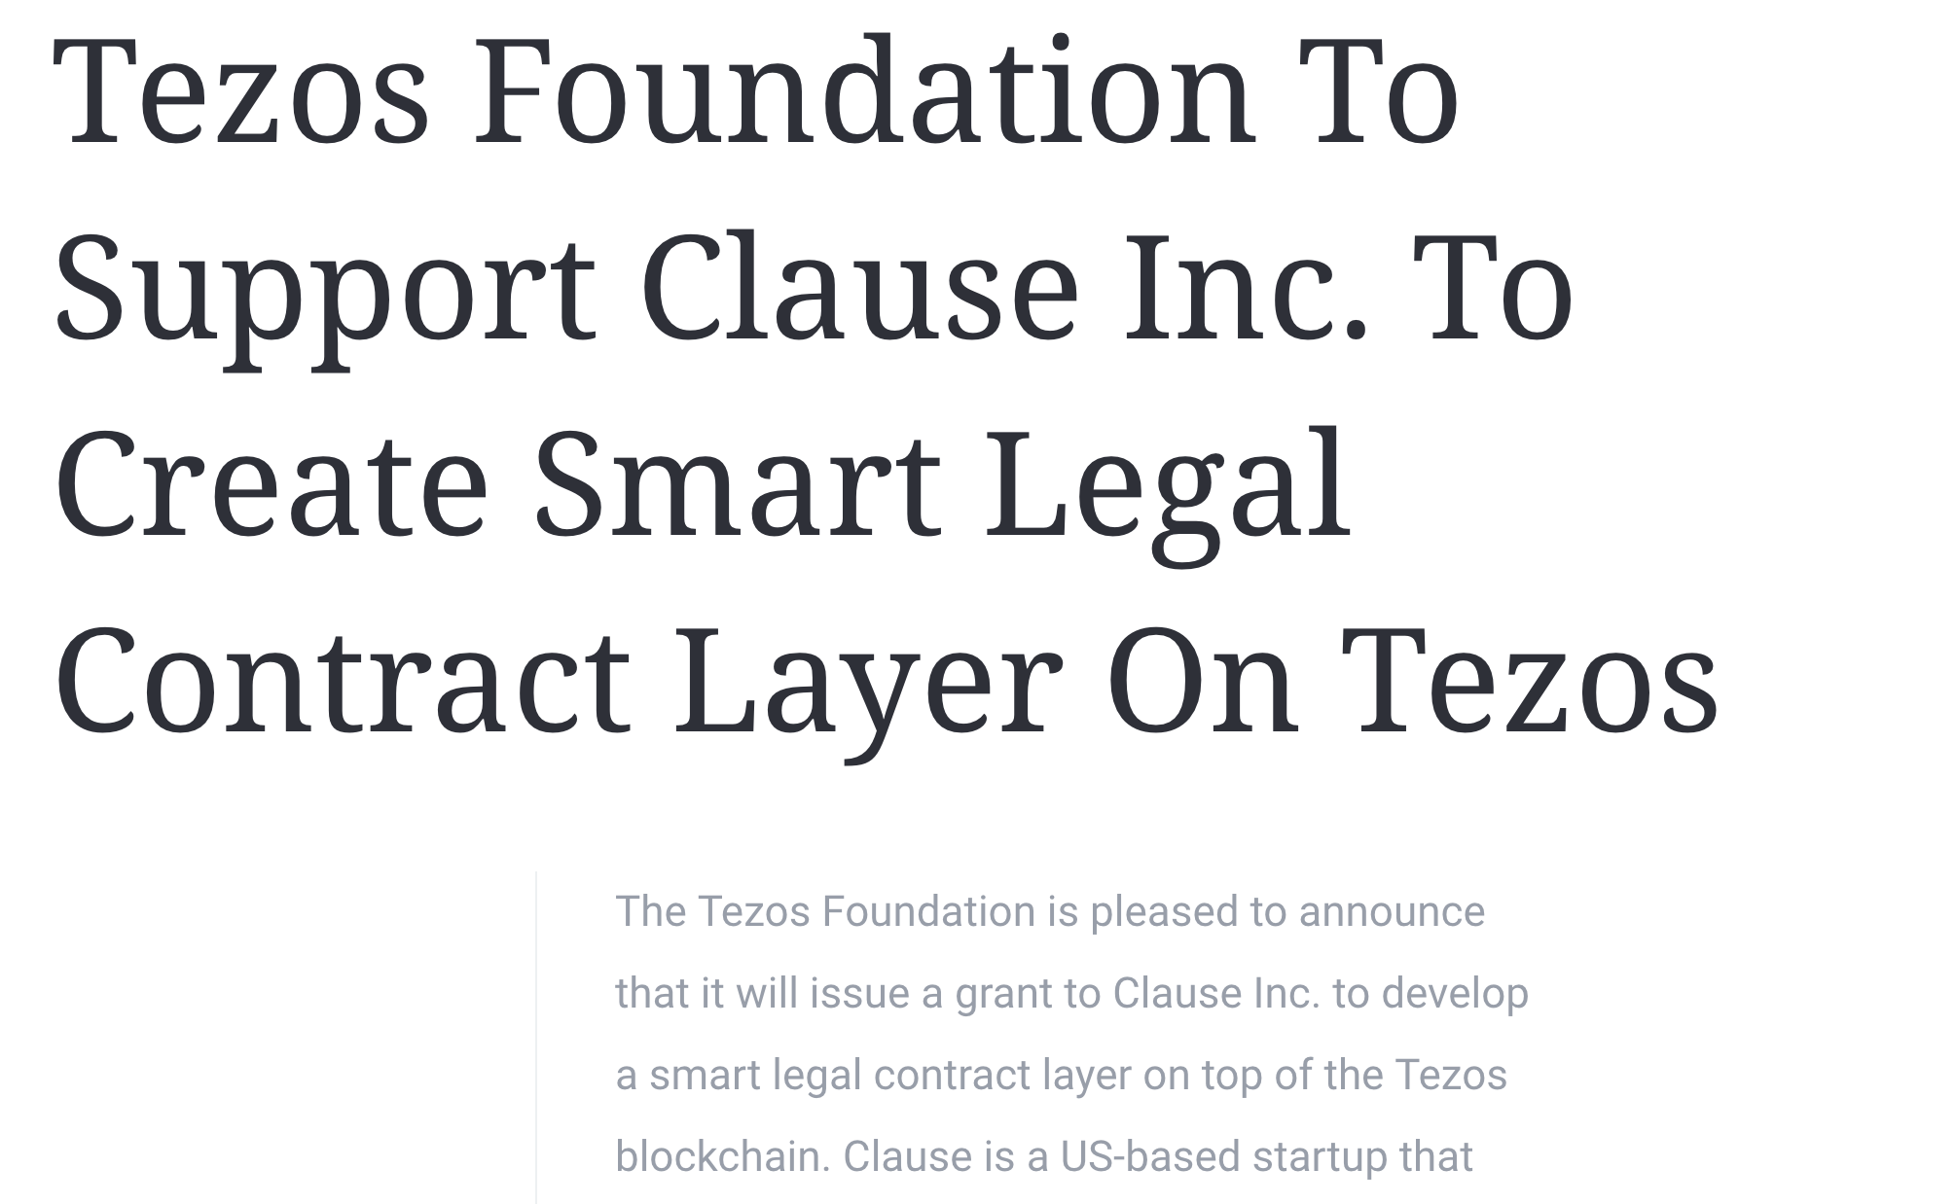
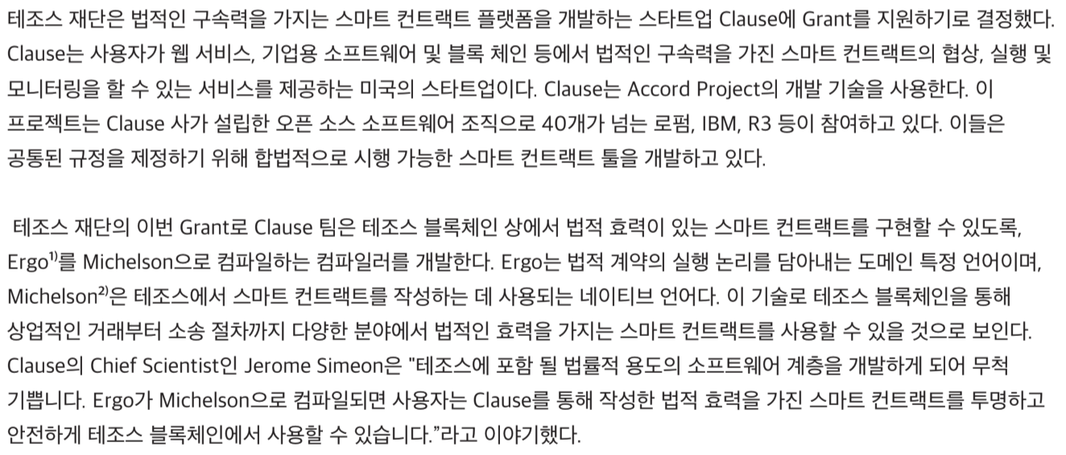
Smart Contract
TEZOS KOREA
Language
- Native language(compile target, run in VM): Michelson
DSL(Domain Specific Language) for automated escrow
stack based
strict static type checking
support formal verification
- High level language Liquidity, Haskell, fi, ergo

Slide 8
Smart Contract
TEZOS KOREA
Automated Escrow
- Best Smart Contract Language?
스마트 컨트랙트란 무엇(이어야 하는가)인가
누가 작성(사용)하는가
ETH vs XTZ
Universal distributed computer Written in JS, Python (General purpose) By any developer | Automate simple (legal) contracts Written in DSLs By Specialized developers

Slide 9
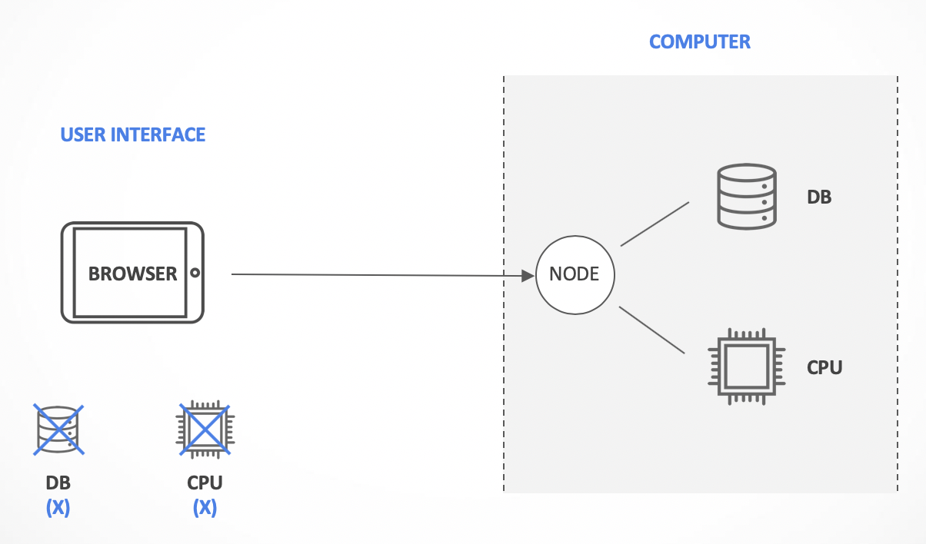
Smart Contract
TEZOS KOREA
Automated Escrow
- ETH | EOS | DEFINITY

Slide 10
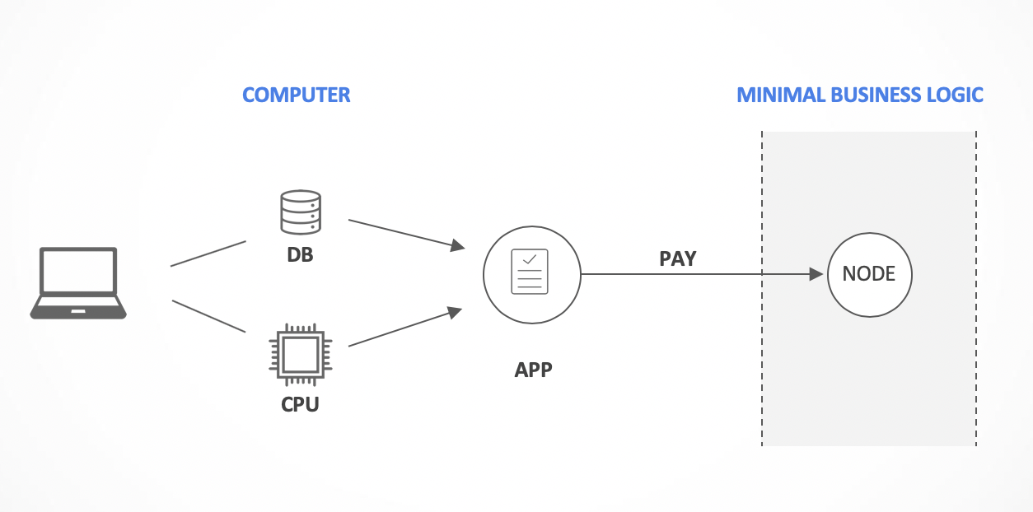
Smart Contract
TEZOS KOREA
Automated Escrow
- TEZOS

Slide 11
Smart Contract
TEZOS KOREA
Automated Escrow
- Off-chain vs. On-chain computation
블록 체인은 기본적으로 매우 느림
블록 체인의 데이터는 매우 비쌈
온체인 / 오프체인 연산의 구분 필요
Bad
Contract : x → sqrt x
App : ( ) → f 9
Good
Contract : x y → if x * x = y then x else fail
App : ( ) → f (sqrt 9) 9

Slide 12
Smart Contract
TEZOS KOREA
Automated Escrow
- Cost(Computation) > Cost(Verification)
Sorting an array
Cryptographic computation
SAT problem
NP-hard problem
- Challenge
블록 체인의 프로그램이 주어졌을 때, 이를 ‘오프체인 계산’과 느린 ‘온체인 검증’으로 분리

Slide 13

Smart Contract
TEZOS KOREA
Tezos SW Component
- Node (Network Shell, API end point)
- Client (Library + built-in wallet)
- Admin Client
- Delegate (Baker, Endorser, Accuser)
Library
Client
Admin
Client
Admin
query
Network
response
Blockchain
Mempool
Node
Delegate
Node
Endorser
Accuse
Node
Baker
Endorser
Accuser
Node
Transactions
Blocks
Protocols

Slide 14
Smart Contract
TEZOS KOREA
Front-End
Web
Mobile
Back-End
Library
Client
Admin
Client
Admin
query
Network
response
Blockchain
Mempool
Node
Delegate
Node
Endorser
Accuse
Node
Baker
Endorser
Accuser
Node
Transactions
Blocks
Protocols

Slide 15
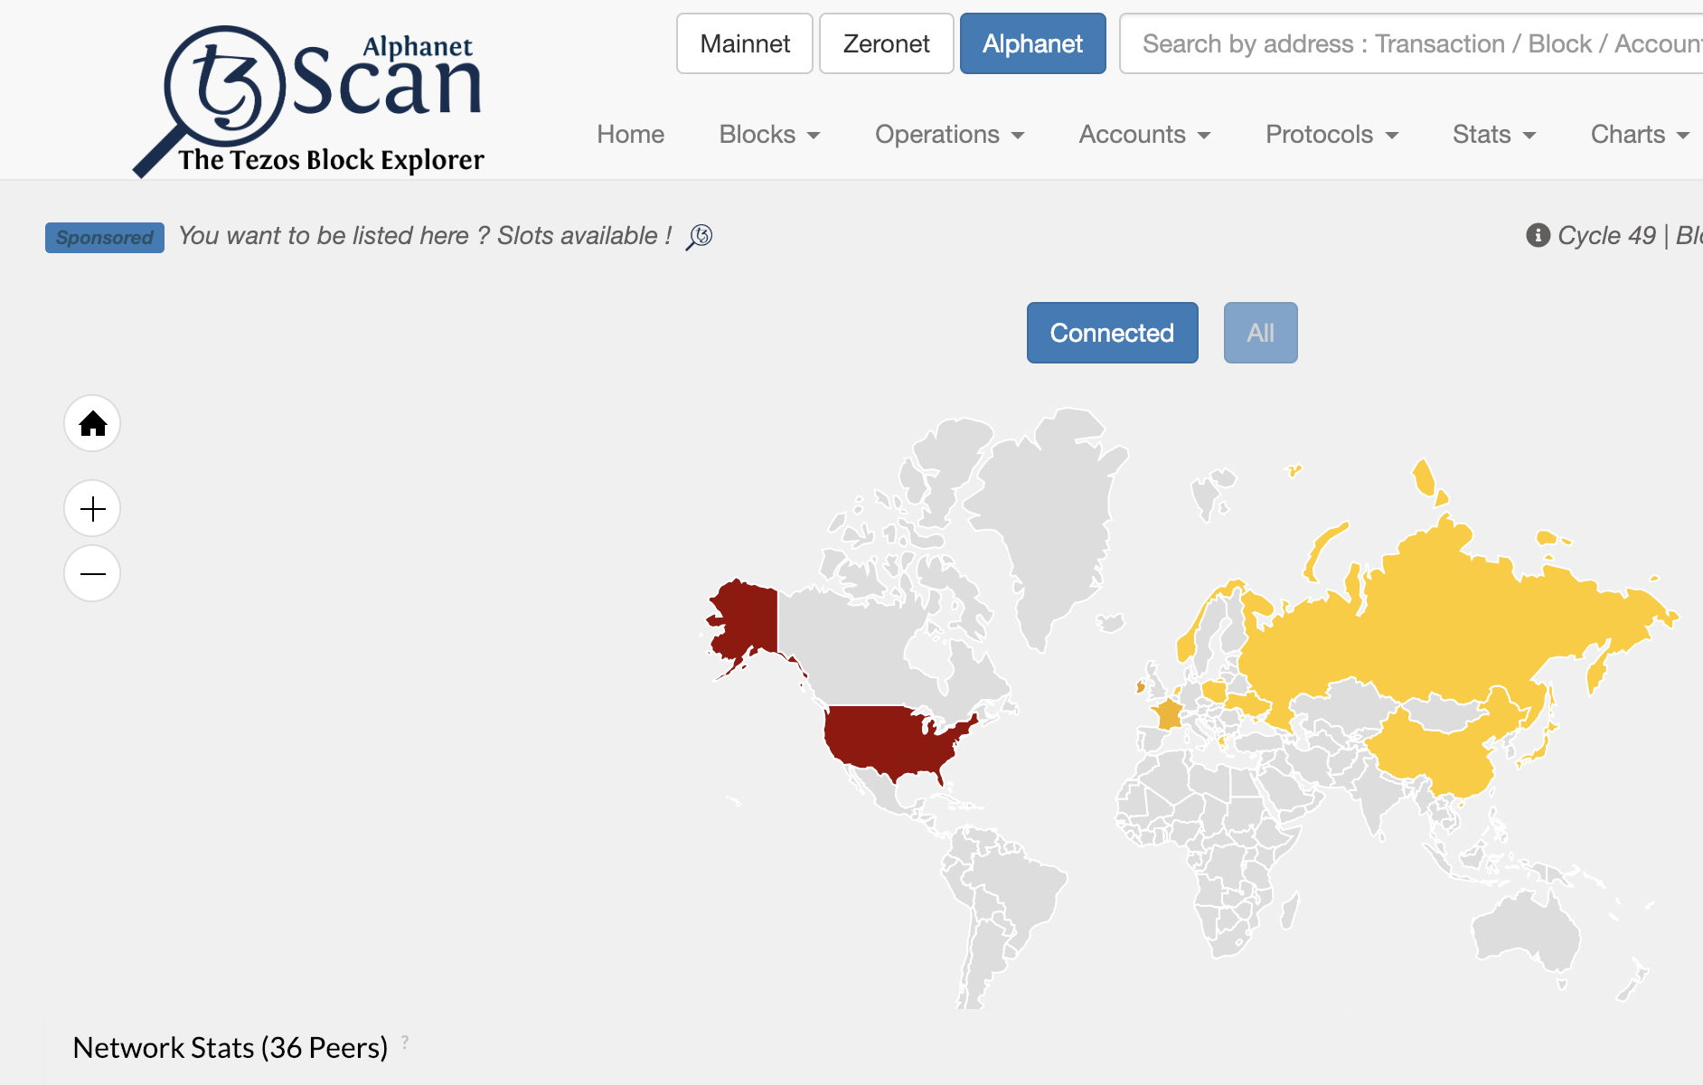
Smart Contract
TEZOS KOREA
Tezos Network
- Mainnet (456 Bakers / 6,529 Nodes)
Live network
Production system
Real Tezzies
- Alphanet (33 Bakers / 650 Nodes)
Test network
Support all updates (staging)
Fake Tezzies
- Zeronet (12 Bakers / 225 Nodes)
Test network
Smaller (Cycle, intervals, …)
For core developers

Slide 16
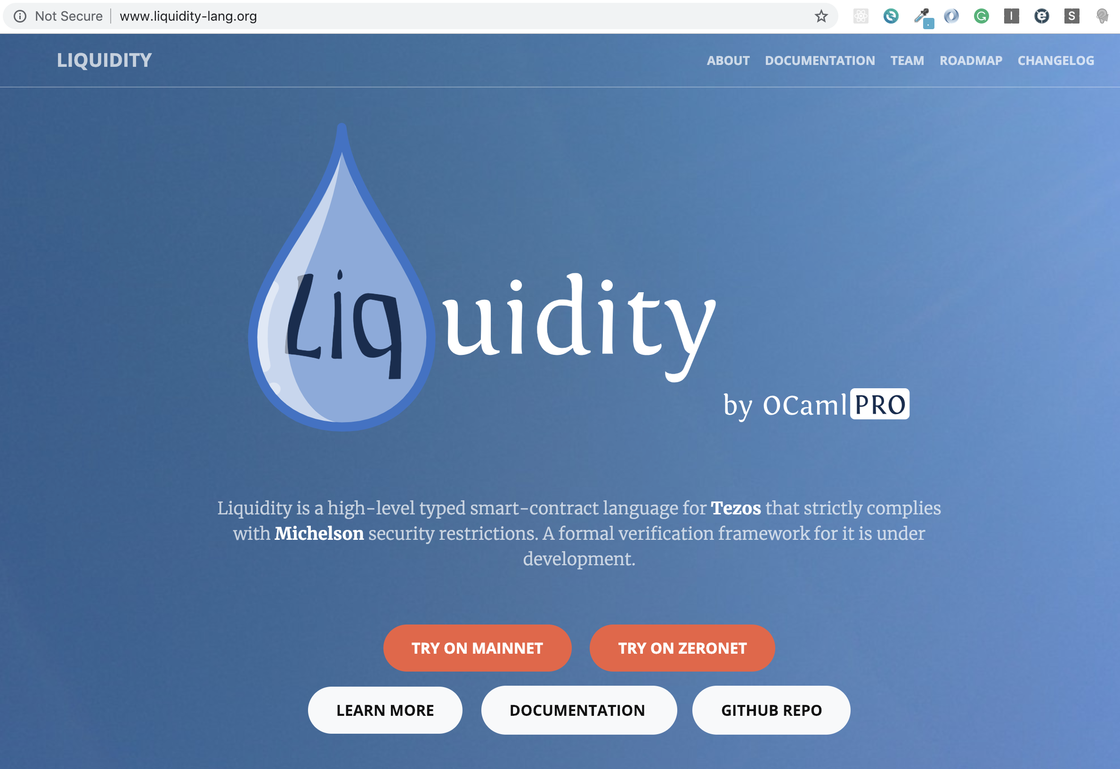
Smart Contract
TEZOS KOREA
Liquidity
liquidity-lang.org

Slide 17
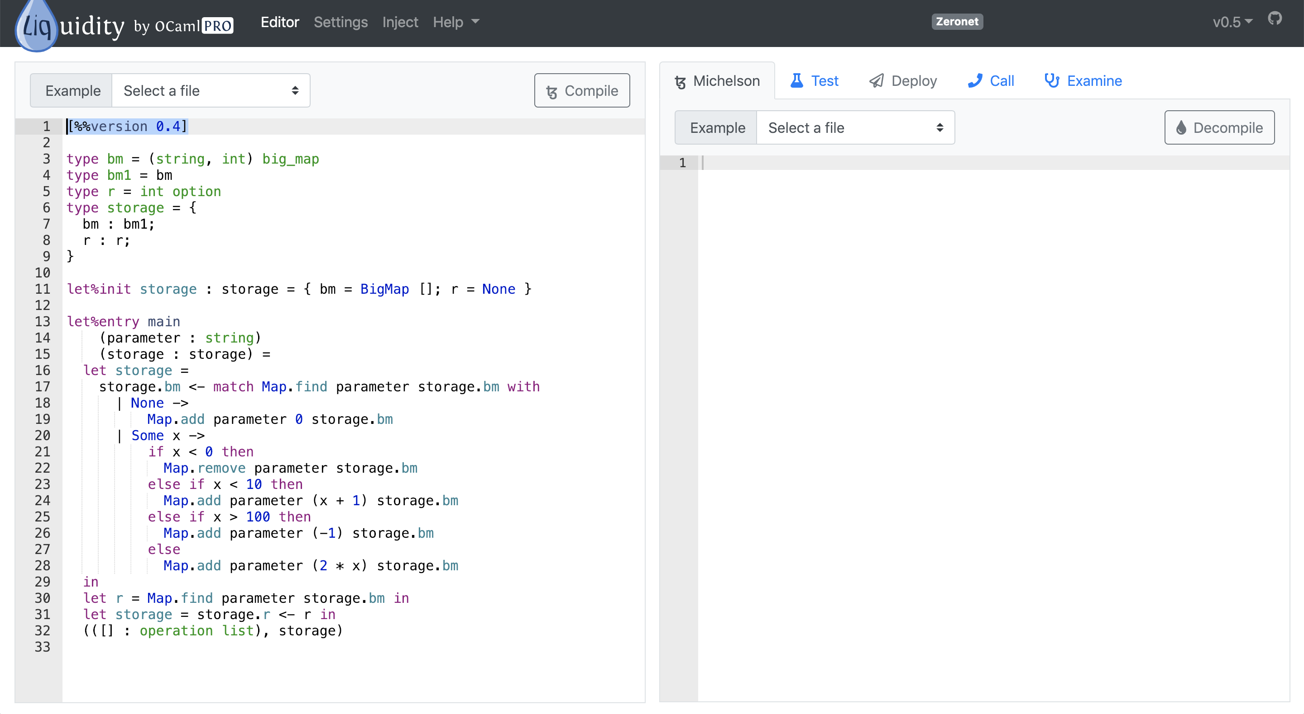
테조스 백서 스터디
TEZOS KOREA

Slide 18
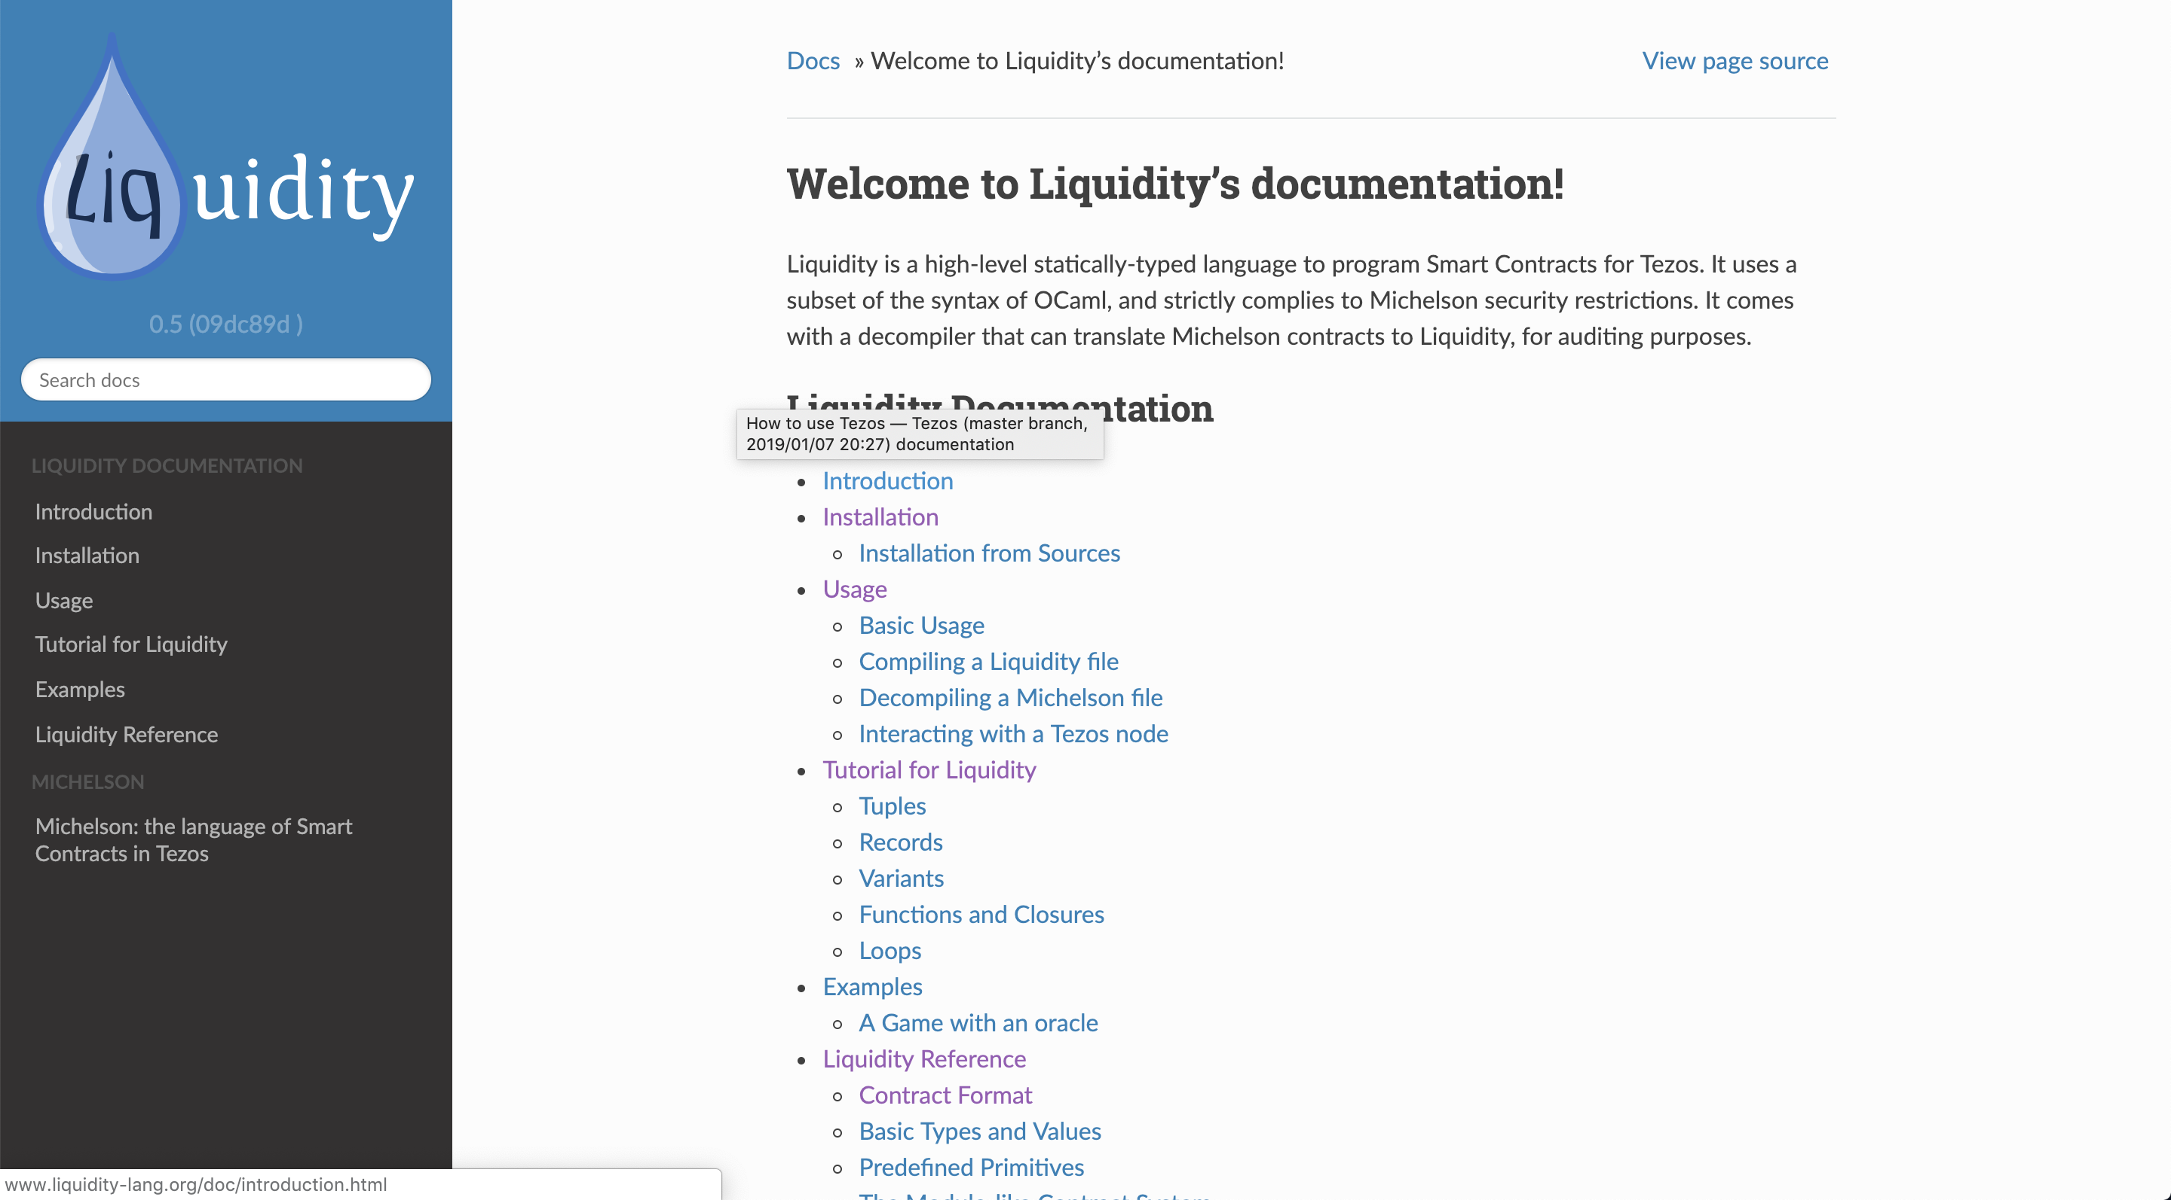
테조스 백서 스터디
TEZOS KOREA

Slide 19
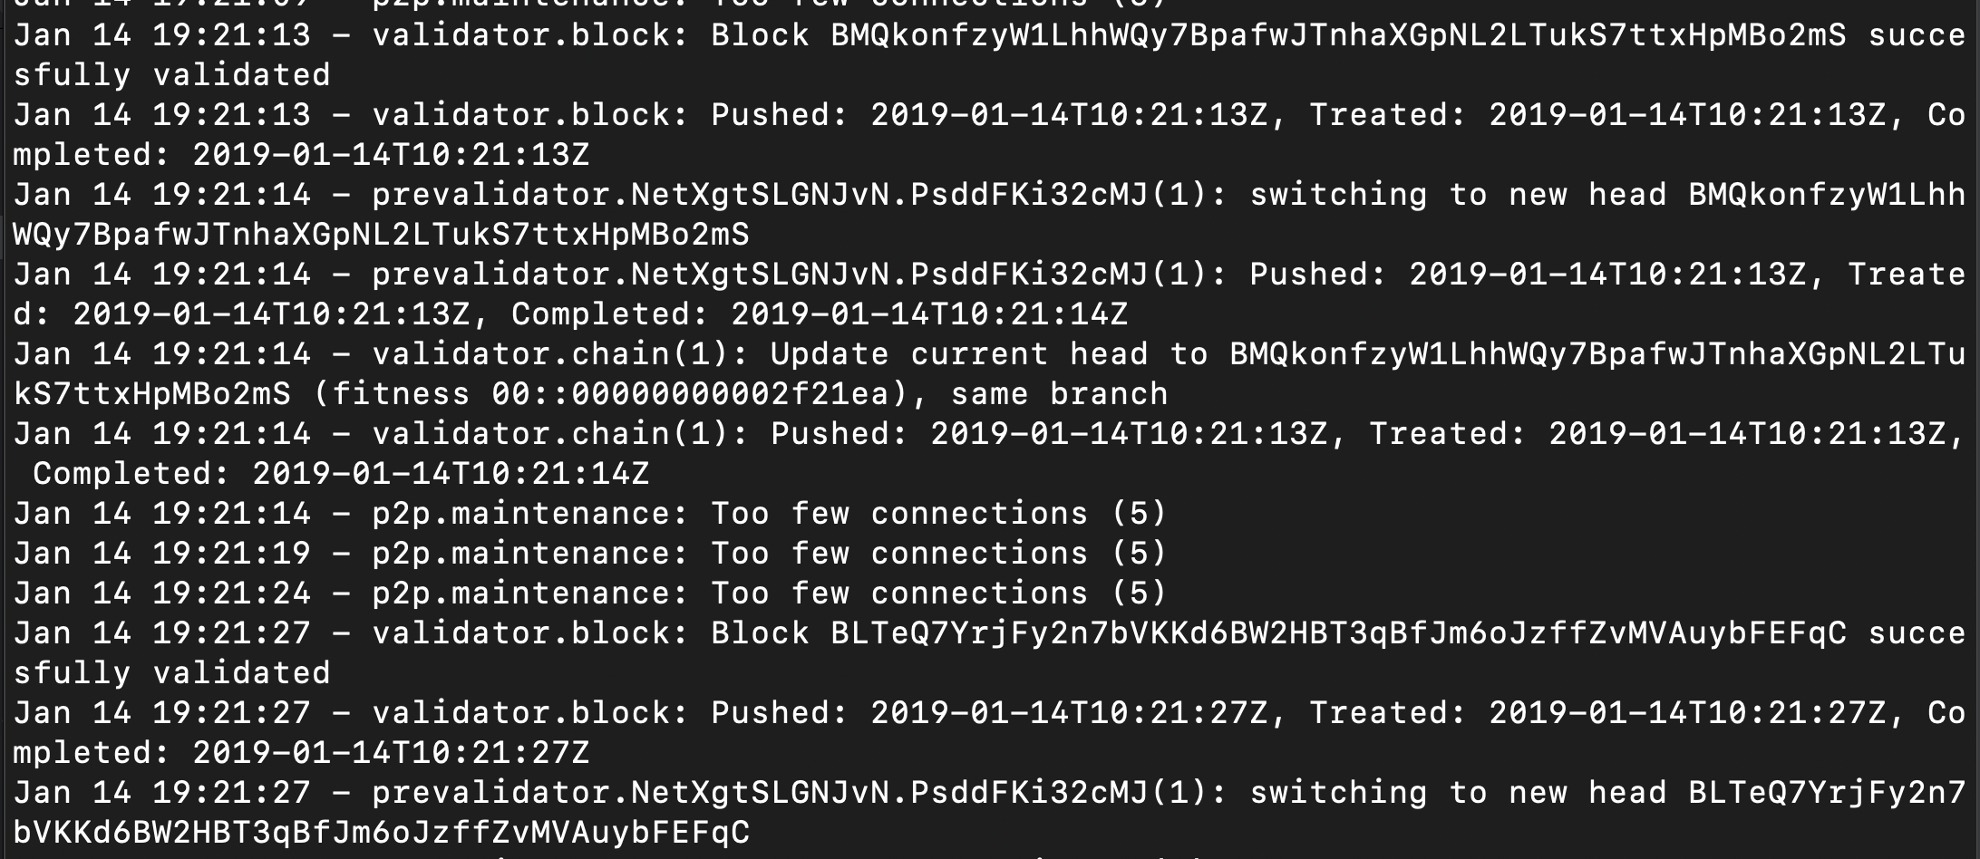
Smart Contract
TEZOS KOREA
Tezos Alphanet
노드 실행
$ ./tezos-node run --rpc-addr 127.0.0.1:8732

Slide 20
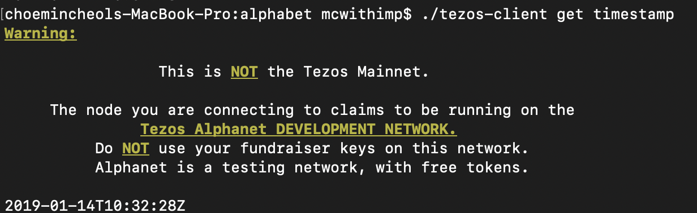
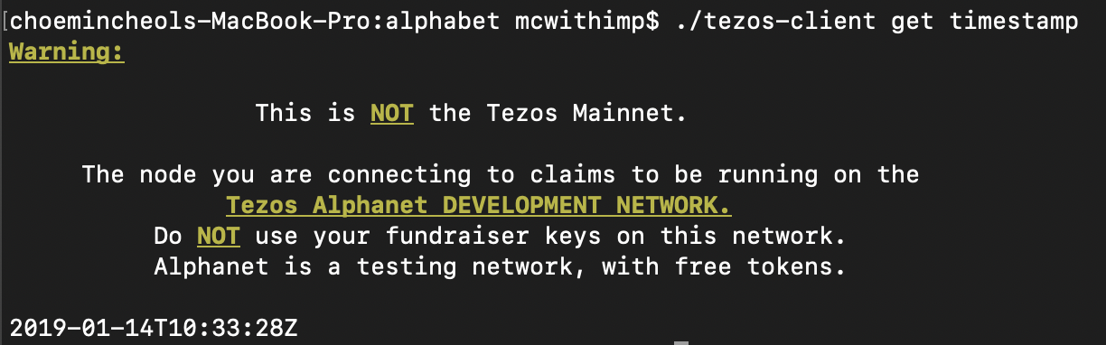
Smart Contract
TEZOS KOREA
Tezos Alphanet
블록 싱킹 확인
$ ./tezos-client get timestamp

Slide 21
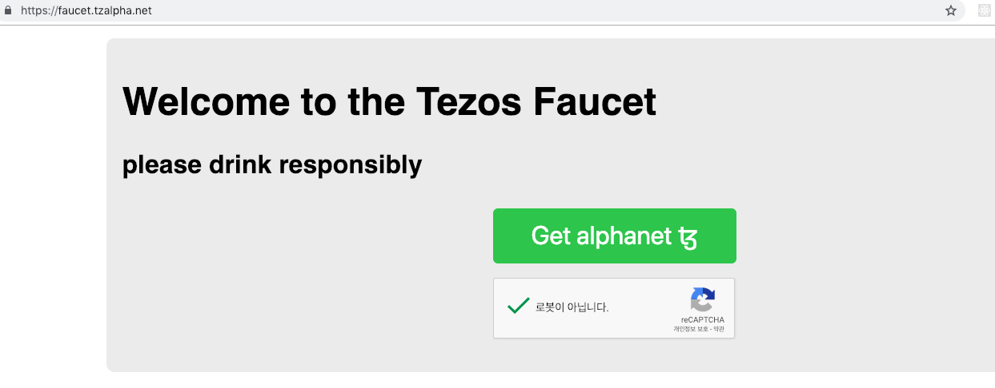
Smart Contract
TEZOS KOREA
Tezos Faucet
faucet.tzalpha.net
클릭하여 json 파일 다운로드 후
alphanet 폴더 아래에 위치 시킵니다.
json 파일을 열고
복사-붙여넣기 해도 됩니다.

Slide 22
Smart Contract
TEZOS KOREA
Tezos Voting Dapp
지갑의 이름으로
아무렇게나 입력해도 됨
지갑 불러오기
$ ./tezos-client activate account tezosWallet with tz1xx.json
주소 확인
$ ./tezos-client list known addresses
Balance 확인
$ ./tezos-client get balance for tezosWallet
주소 정보
$ ./tezos-client show address tezosWallet
$ ./tezos-client show address tezosWallet -S
faucet에서 다운로드 한
json 파일

Slide 23
Smart Contract
TEZOS KOREA
Front-End
Web
Mobile
Back-End
Library
Client
Admin
Client
Admin
query
Network
response
Blockchain
Mempool
Node
Delegate
Node
Endorser
Accuse
Node
Baker
Endorser
Accuser
Node
Transactions
Blocks
Protocols

Slide 24
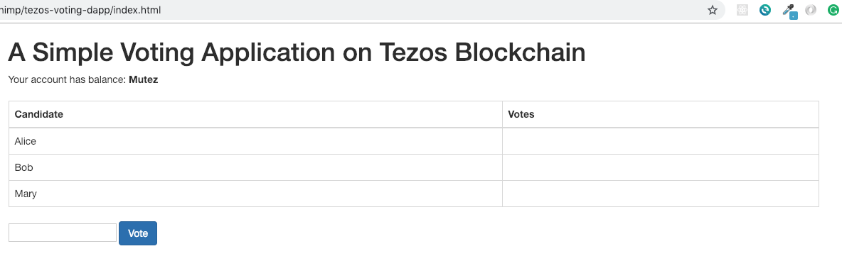
Smart Contract
TEZOS KOREA
Tezos Voting Dapp
Front-End
Node

Slide 25
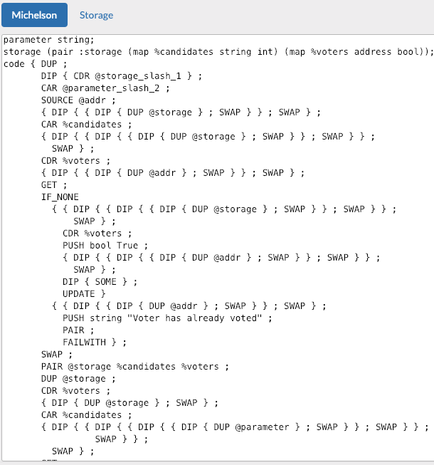
Smart Contract
TEZOS KOREA
Tezos Voting Dapp
Back-End
Node

Slide 26
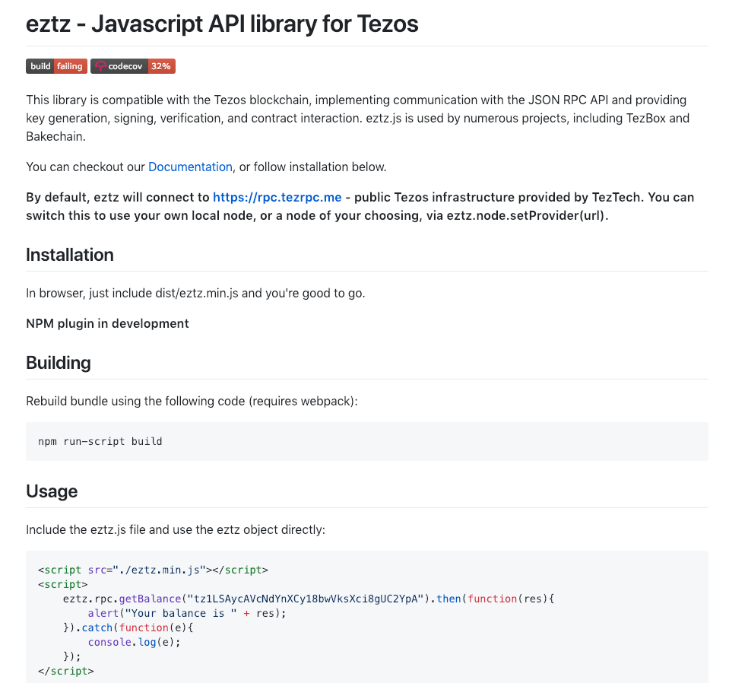
Smart Contract
TEZOS KOREA
Tezos Voting Dapp
github.com/TezTech/eztz
- eztz connects to
rpc.tezrpc.me
local node
any node accessible
- eztz.node.setProvider(url)
"http://localhost:8732"

Slide 27
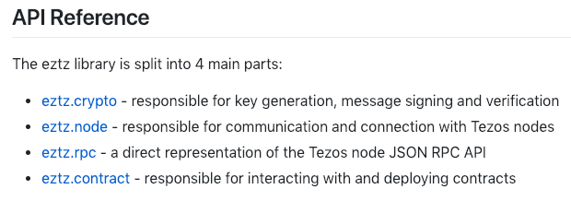
Smart Contract
TEZOS KOREA
Tezos Voting Dapp
github.com/TezTech/eztz
- eztz.crypto
key gen
msg sign / verification
- eztz.node
communication
connection
- eztz.rpc
Node JSON RPC API
- eztz.contract
interact with / deploy contracts

Slide 28
Smart Contract
TEZOS KOREA
Tezos Voting Dapp
- 스마트 컨트랙트를 배포하면서, 선거에 참가하는 후보 등록
후보 이름 리스트 : string list
스토리지 초기 값 : map associate list. [ (“Choi”, 0); (”Kim”, 0); …]
- 특정 후보에 투표 시, 그 후보의 득표 수 1 증가
- 투표자는 한 번만 투표 가능

Slide 29
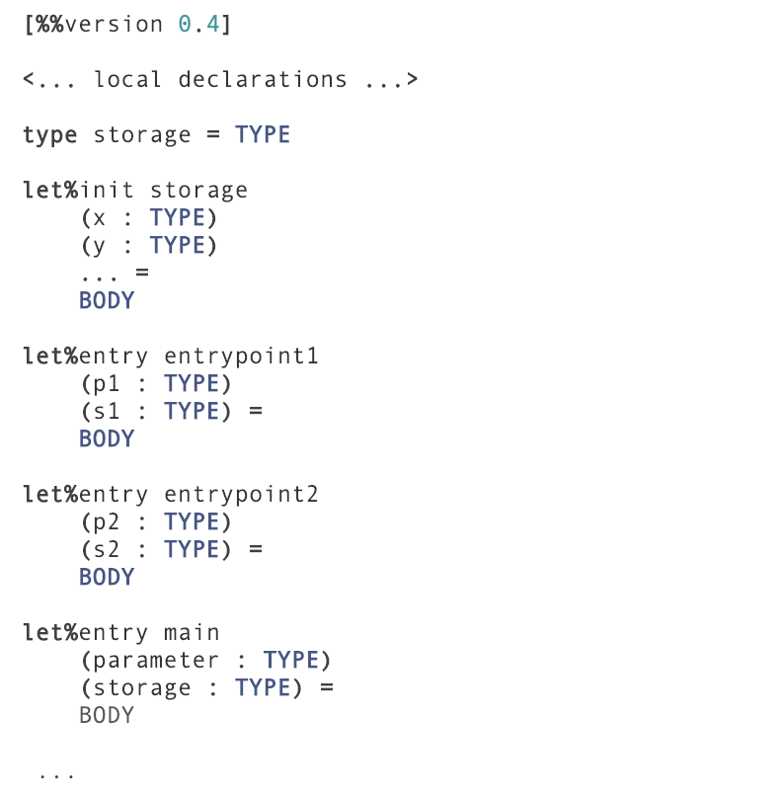
Smart Contract
TEZOS KOREA
Contract Format
- storage
컨트랙트의 상태 값으로 반드시 선언
- let%entry 함수이름
함수 선언, 파라미터와 스토리지를 인자로 받음
- init
Contstructor, 컨트랙트 배포 시 한 번만 실행
- main
fallback, entry point 없이 컨트랙트 호출 시 실행
- return type
모든 entrypoint는 (operation list, storage)를 리턴
operation은 컨트랙트 수행 후 적용되어야 할 내부 op

Slide 30
Smart Contract
TEZOS KOREA
Contract Deploy
컨트랙트 배포
$ liquidity \ --tezos-node localhost:8732 \
--private-key edsk2i…RG \
--deploy ‘[“Moon”; “Ahn”; “Hong”]’
$ ~/.opam/liquidity/bin/liquidity \ --tezos-node localhost:8732 \
--private-key edsk2i…RG \
--deploy ‘[“Moon”; “Ahn”; “Hong”]’
Mac
Linux

Slide 31
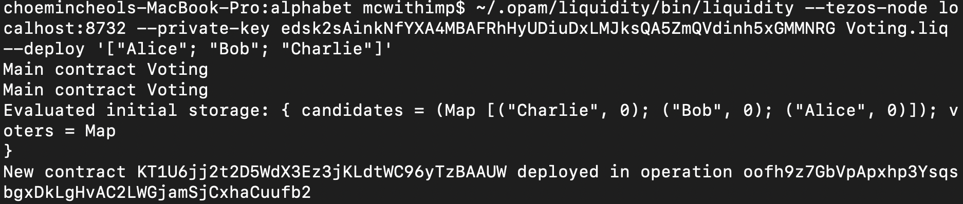
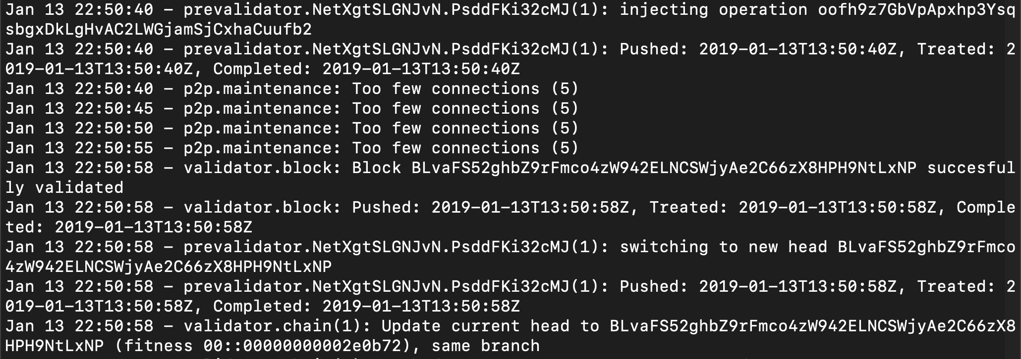
Smart Contract
TEZOS KOREA
Contract Deploy
- Injection Operation Hash : oofh9z7GbVpApxhp3YsqsbgxDkLgHvAC2LWGjamSjCxhaCuufb2
- Originated Account Hash : KT1U6jj2t2D5WdX3Ez3jKLdtWC96yTzBAAUW

Slide 32
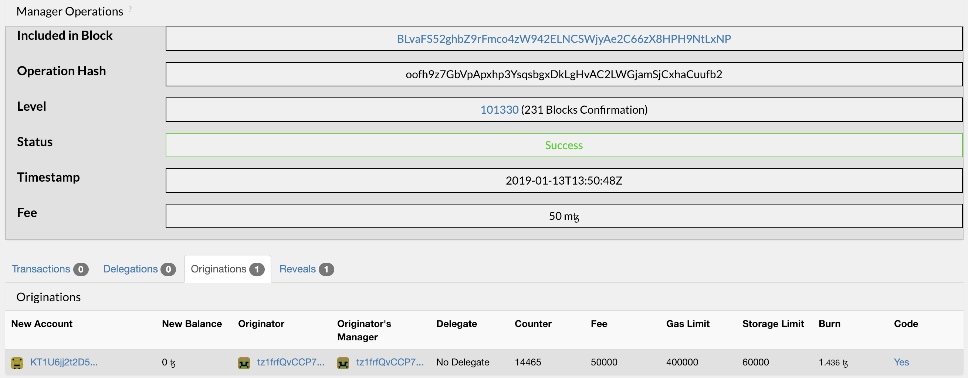
Smart Contract
TEZOS KOREA
Contract Deploy
- Injection Operation Hash : oofh9z7GbVpApxhp3YsqsbgxDkLgHvAC2LWGjamSjCxhaCuufb2
- Originated Account Hash : KT1U6jj2t2D5WdX3Ez3jKLdtWC96yTzBAAUW

Slide 33
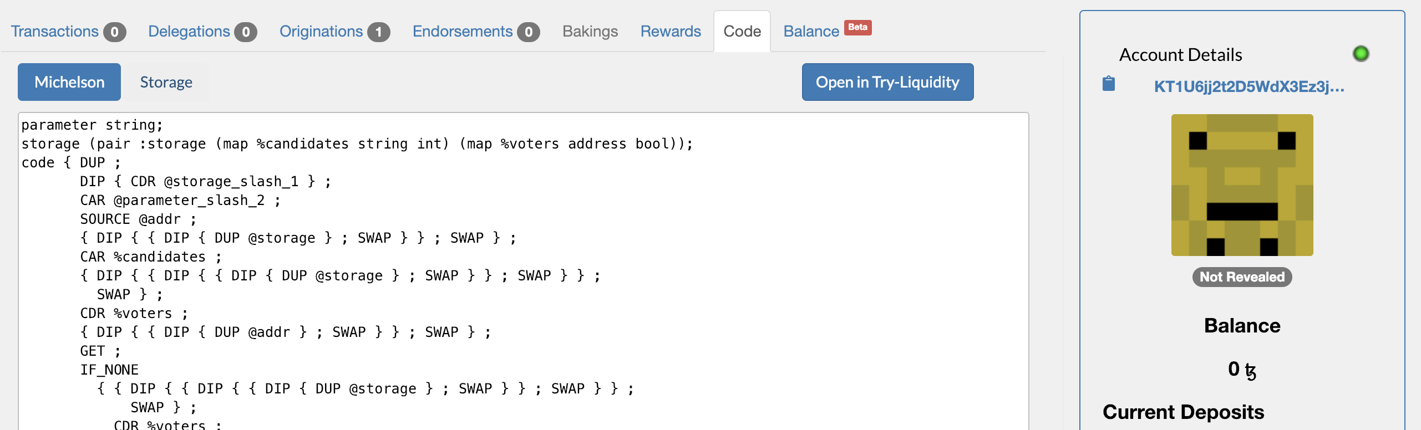
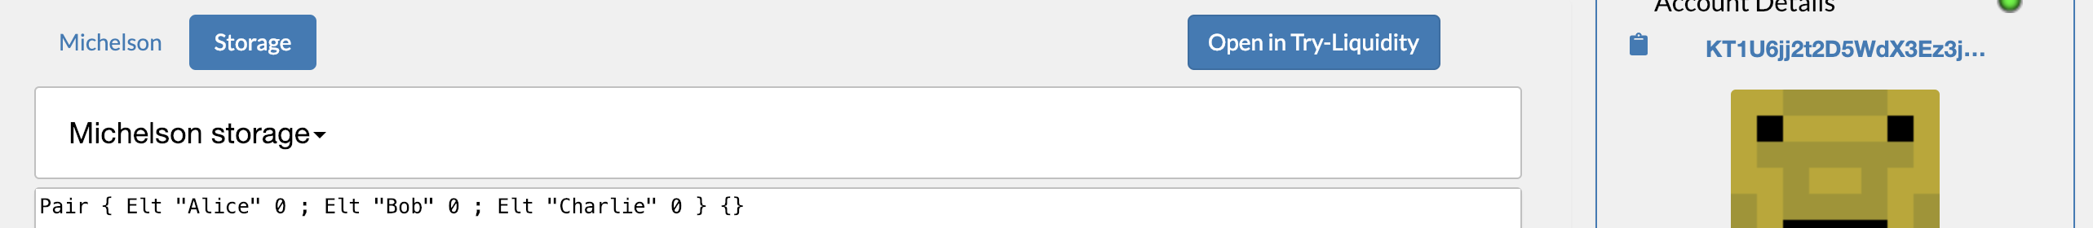
Smart Contract
TEZOS KOREA
Contract Deploy
- Injection Operation Hash : oofh9z7GbVpApxhp3YsqsbgxDkLgHvAC2LWGjamSjCxhaCuufb2
- Originated Account Hash : KT1U6jj2t2D5WdX3Ez3jKLdtWC96yTzBAAUW

Slide 34
Smart Contract
TEZOS KOREA
Tezos Voting Dapp
Front-End Code
$ git clone \ https://github.com/mcwithimp/tezos-voting-dapp.git
Node Config 수정
‘~/.tezos-node/config.json’ 파일 내용 아래와 같이 수정
{ "rpc": { "listen-addr": "127.0.0.1:8732", "cors-origin": ["*"], "cors-headers": ["*"] }, "p2p": { "listen-addr": "[::]:9732" } }

Slide 35
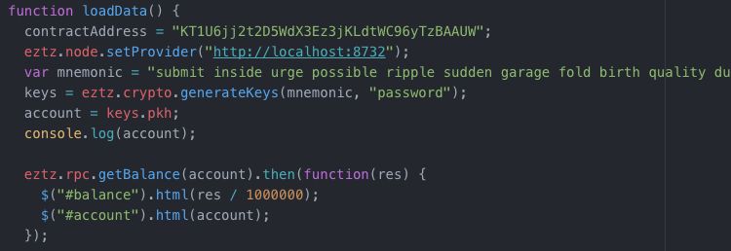
Smart Contract
TEZOS KOREA
Tezos Voting Dapp
Valid Mnemonic
$ cat ./tz1xx.json
app.js 수정

Slide 36
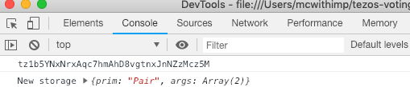
Smart Contract
TEZOS KOREA
Tezos Voting Dapp
새 주소 생성
토큰 전송
$ ./tezos-client transfer 100 from tezosCamp to \
tz1b5YNxNrxAqc7hmAhD8vgtnxJnNZzMcz5M \
--burn-cap 0.257

Slide 37
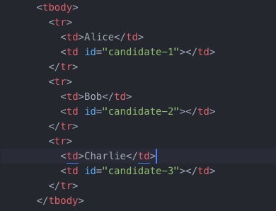
Smart Contract
TEZOS KOREA
Tezos Voting Dapp
index.html 수정

Slide 38
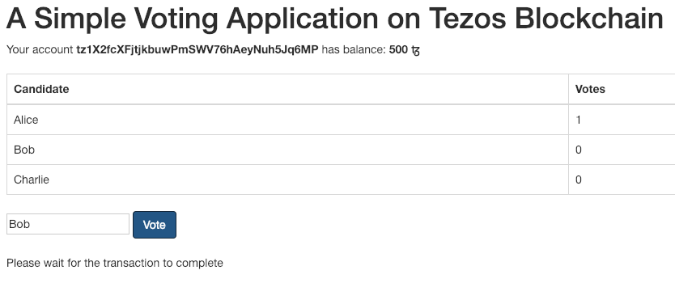
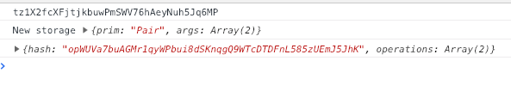
Smart Contract
TEZOS KOREA
Tezos Voting Dapp
투표

Slide 39
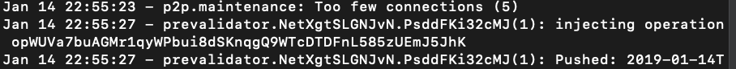
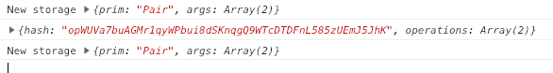
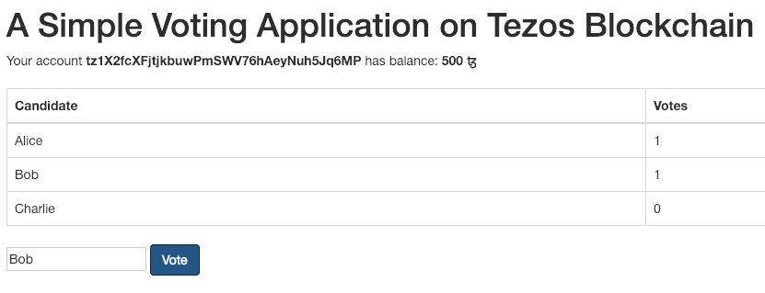
Smart Contract
TEZOS KOREA
Tezos Voting Dapp
투표

Slide 40
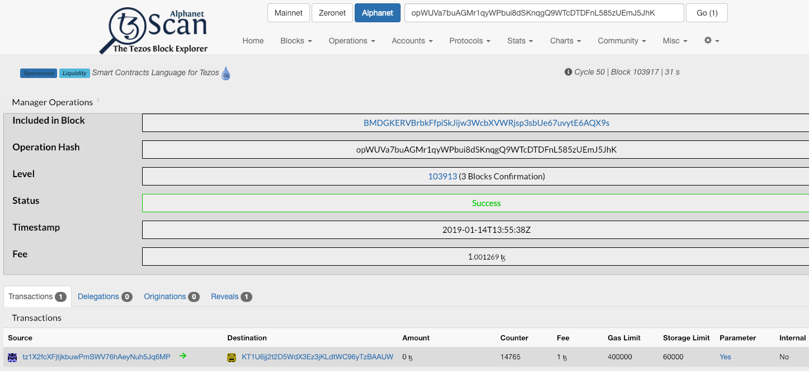
Smart Contract
TEZOS KOREA
Tezos Voting Dapp
투표

Slide 41
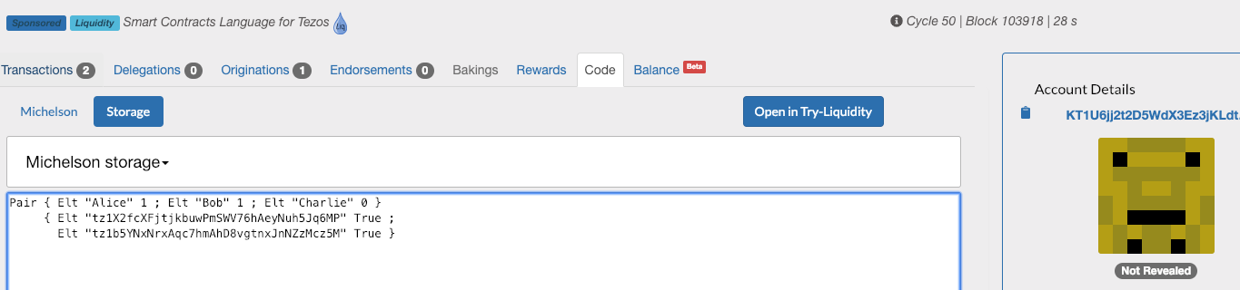
Smart Contract
TEZOS KOREA
Tezos Voting Dapp
투표

Slide 42
